Slide 1
Security Features
Jocelyn Daja

Slide 2

Password HASHING
Coverts the Password to hasign format which doesn’t allow any other user to recognize any password.
The screenshot shows a record of a registered user which has the password hashed.

Slide 3
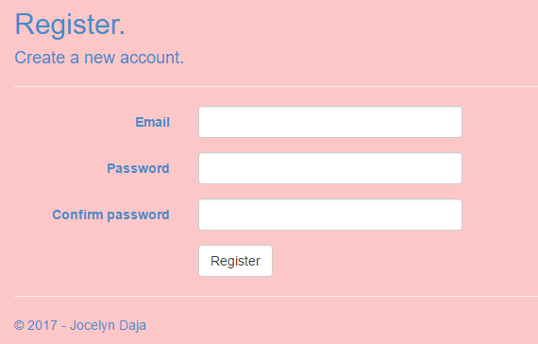
Authentication and authorization
All users should register before using the website
Given that all credentials are carried out correctly in the given fields, a new user will be added in the db.

Slide 4
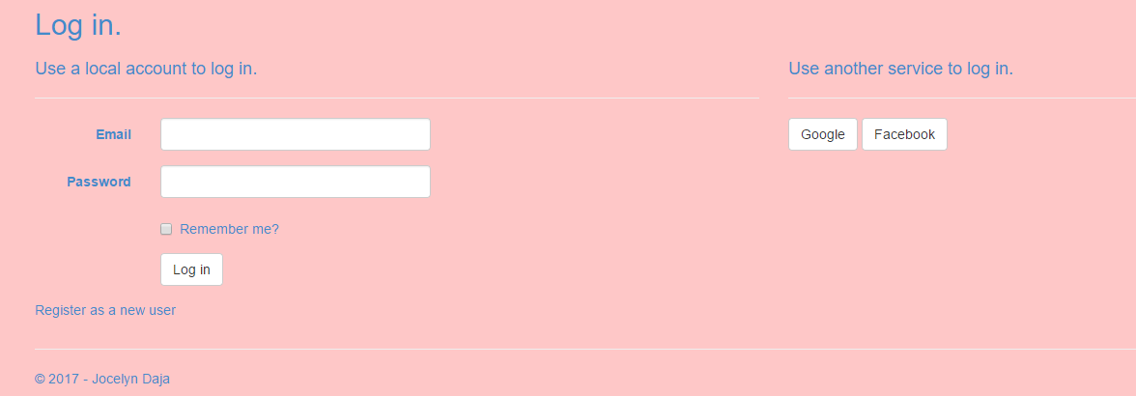
Authentication
Login Page where user enters the correct credentials to log in.
Credentials Entered should match the credentials in the Database.
No access if mismatch.

Slide 5
Authorization
There are three different roles in this system.
The Guest, User and Admin.
They all have different authorizations.
Example Guest can’t upload image
Has to log in.

Slide 6
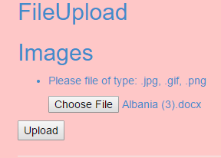
Correct format
This website only accepts images of .jpg/.png/.gif format.
Any other format is rejected.

